Slide 1


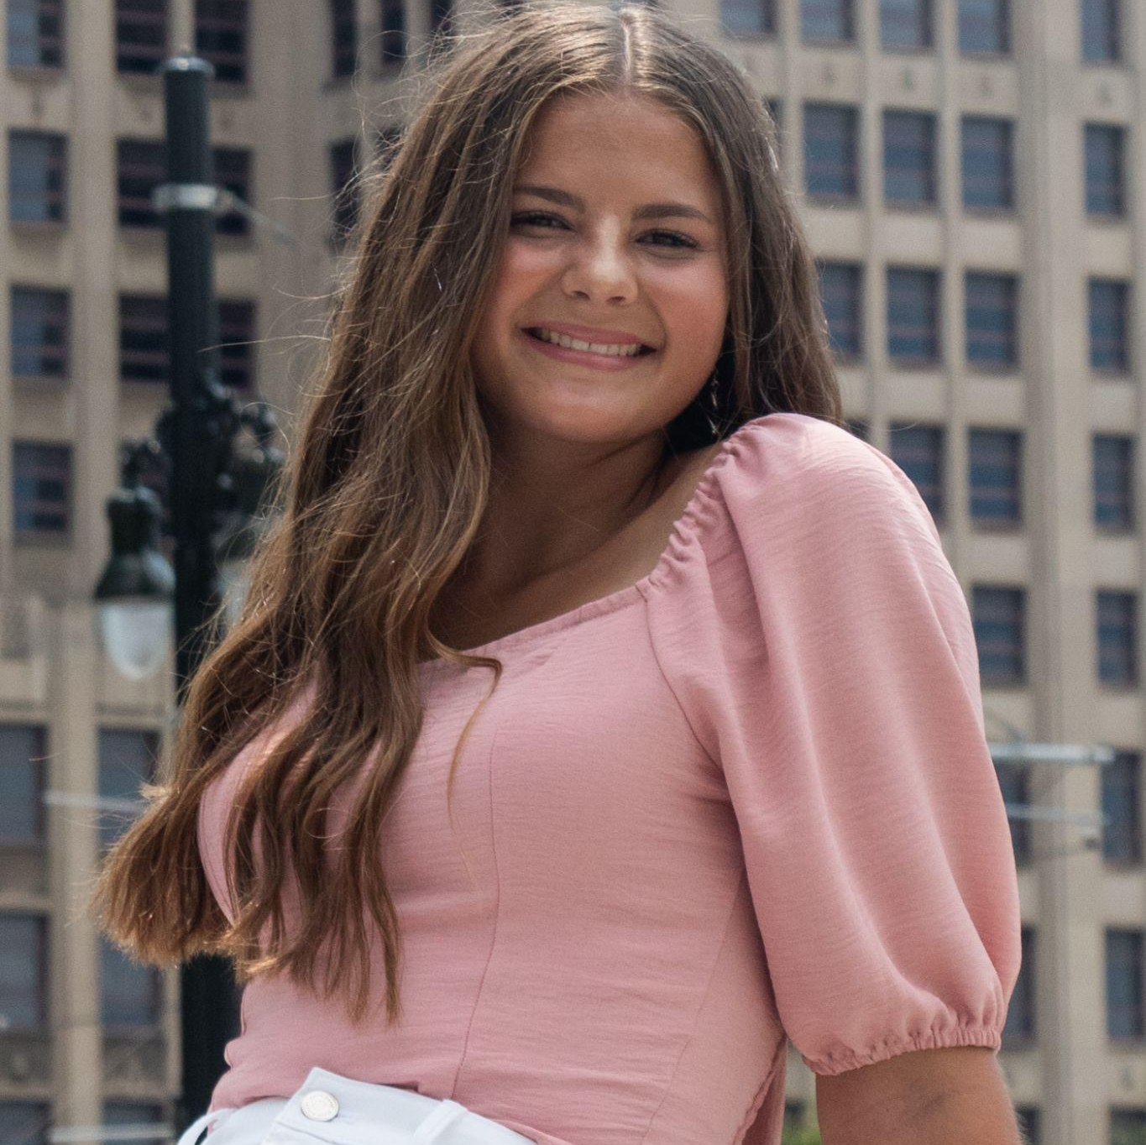
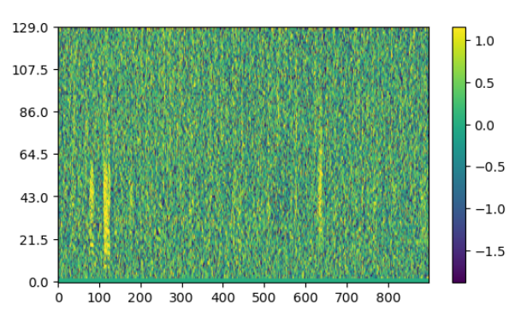
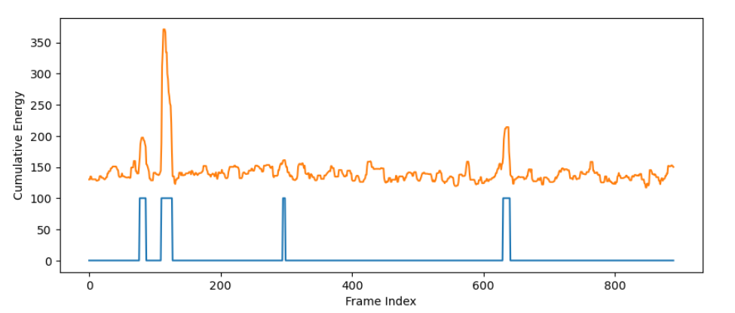
Felicia Huffman
Data Science Graduate Student
Michigan Technological University | College of Computing
Research: AI/ML Based | Area: Underwater Acoustics
Email: fmhuffma@mtu.edu
Power-Law Transformed Spectrogram
Identifying Potential Fish Calls

